Slide 1

Today’s Lab
Additional Questionnaire Design Features.
  Putting the final touch on the questionnaire from last week.
Snap Online.
  Upload Snap Surveys
  Interview Settings
  Invite Respondents
MKTG2341-09 PCLab 6

Slide 2
Two Elements of Snap
Snap 9 Professional
  Used to design the questionnaire.
  Only accessible in the Labs and the Library.
Snap Online
  Used to upload and host the survey.
  Once the data collection is completed, we download the data from Snap Online ‘into the questionnaire file’.
  Warning: make sure that each group member has a back-up copy of the uploaded file and that you have not made a single change to it.
MKTG2341-09 PCLab 6

Slide 3
Additional Questionnaire Features
Use the question format: Instructions
Screening Question
Exit Comment for respondents who did not qualify for the survey & go to the End.
Routing ‘After this Question’ to jump over the above Exit comment.
Exit Comment for respondents who qualified for the survey & go to the End.
Page Breaks before all skipped questions.
MKTG2341-09 PCLab 6

Slide 4
Snap Online
Upload Snap Surveys
Interview Settings
Invite Respondents
Download Data
MKTG2341-09 PCLab 6
Notes:
Most of this is covered in Guide 5. Online Interviewing & Analysis

Slide 5
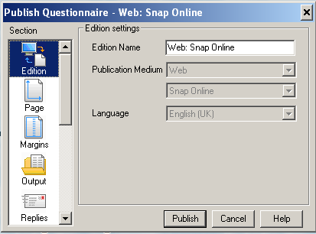
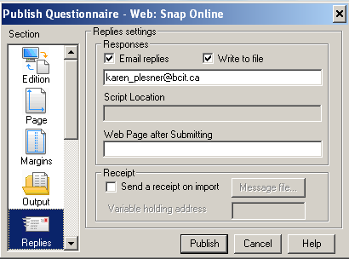
Publishing the Questionnaire
Start: Go into Snap 9.
To publish the q’naire: File>Publish
Adjust settings as shown
Replies:
Email address We are not using this to mail out, so it does not have to be real.
Edition:
Snap Online
MKTG2341-09 PCLab 6
Notes:
If it is not in a Snap Web Online format, change it as follows:
File | Edition | New | Web Online| OK

Slide 6
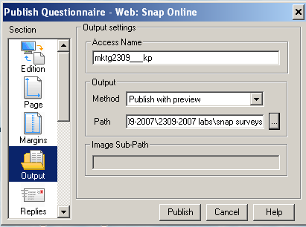
Publishing the Questionnaire
The name of the survey
When publishing a questionnaire from Snap 9 Professional it saves the questionnaire in a .zip file format.
Zip file located in the path specified from the output window.
Note: do not use path H (personal files) for this.
MKTG2341-09 PCLab 6
Click Publish

Slide 7
Snap Online
Once you have your own account you login to Snap Online:
http://snapsurvey.bcit.ca/snaponline
Username= A00123456
Password= snap_ _ _
Your BCIT
A00… number
Case sensitive
last 3 digits of the A00… number
Case sensitive
MKTG2341-09 PCLab 6

Slide 8
TODAY: Snap Online
Today you will log in to a generic account:
http://snapsurvey.bcit.ca/snaponline
Username= A100000000
Password= SnapTempG
Seven zeros
Case sensitive
Case sensitive
MKTG2341-09 PCLab 6

Slide 9
Snap File
For this lab, you need a Snap file to work with.
It can be your group survey or another Snap file
Make a copy of your file and rename it:
      snSetLastname.mdf
  Ex: snSetBJopling.mdf
You will use this file to upload to Snap Online.
Before you leave this lab, please delete that file from Snap Online.
MKTG2341-09 PCLab 6

Slide 10
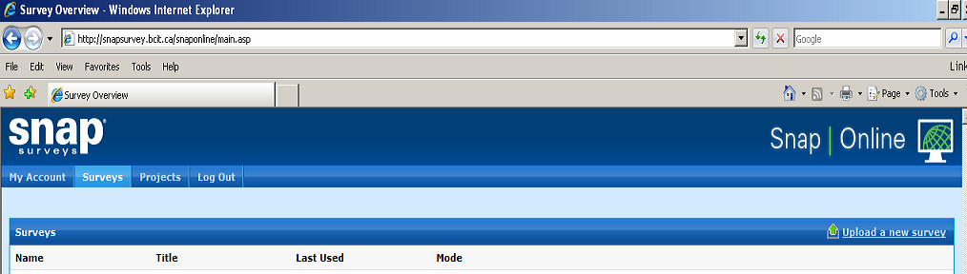
Uploading Snap Surveys
Select the Surveys tab
Click Upload a new Survey
MKTG2341-09 PCLab 6

Slide 11
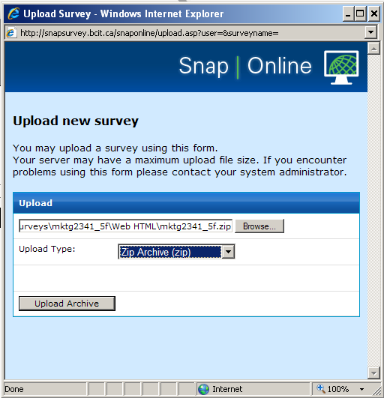
Uploading Snap Surveys
Browse to the location of your .zip questionnaire
Upload Type:
Zip Archive (zip)
MKTG2341-09 PCLab 6
Click Upload Archive

Slide 12
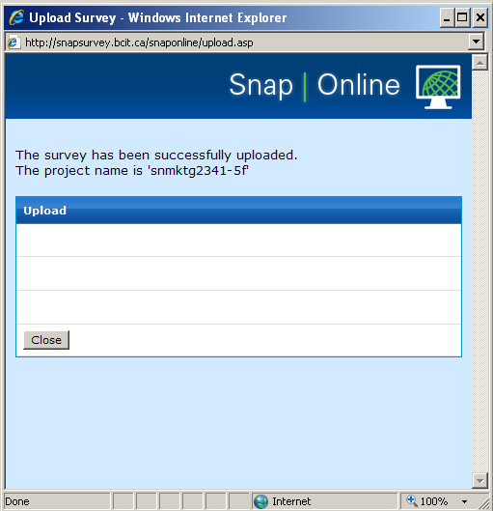
Uploading Snap Surveys
Message to say that you have now uploaded the survey and what the name is
Click Close
MKTG2341-09 PCLab 6
MKTG2309 PC Lab Snap

Slide 13
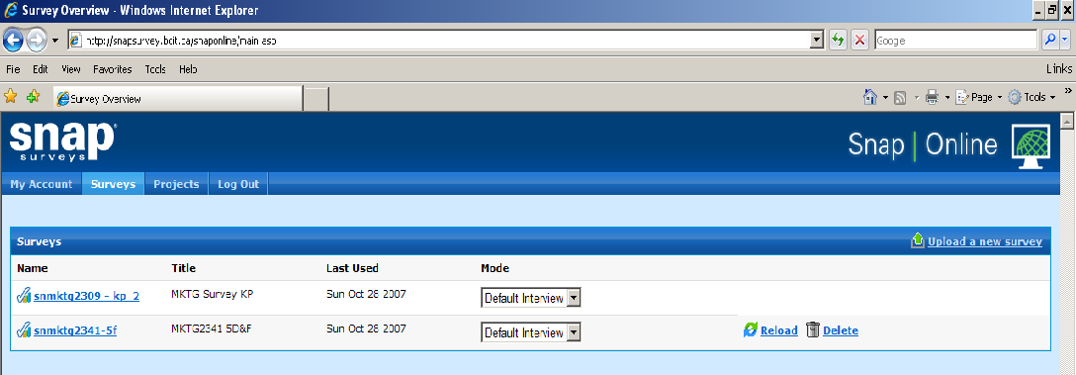
Uploading Snap Surveys
Your survey should now appear in the list of surveys.
Next, Click on the Survey Name
MKTG2341-09 PCLab 6

Slide 14
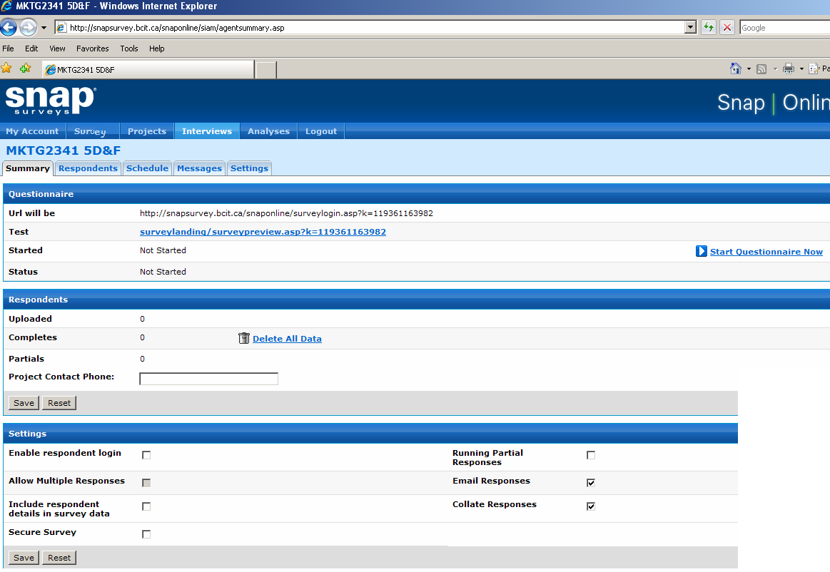
Interview Summary Tab
5 Tabs to define the interview
MKTG2341-09 PCLab 6

Slide 15
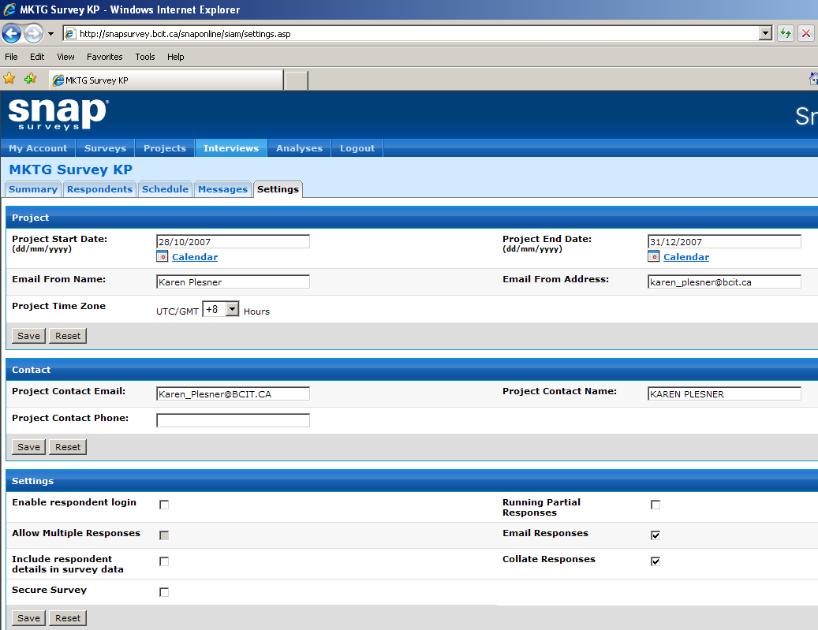
Interview Settings Tab
Click Interviews
Click Settings tab
Click Interviews
Click Settings tab
Specify:
Project, Contact, Settings
MKTG2341-09 PCLab 6

Slide 16
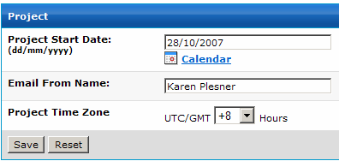
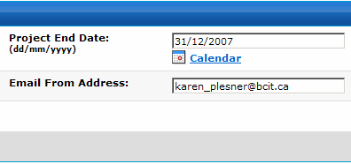
Interview Settings: Project
Start date
Sender’s Name
Time Zone
Save
Save
End date
Sender’s email
MKTG2341-09 PCLab 6
Notes:
Details from slide 10

Slide 17
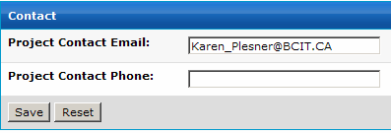
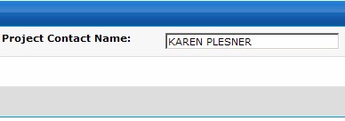
Interview Settings: Contact
Save
MKTG2341-09 PCLab 6
Notes:
Details from slide 10

Slide 18
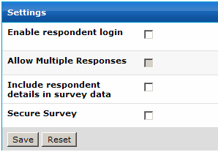
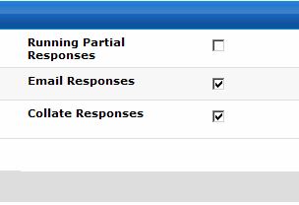
Interview Settings: Settings
Click:
Email Responses
Collate Responses
Save
MKTG2341-09 PCLab 6
Notes:
Details from slide 10

Slide 19
Run a Test Survey
To test that the survey works and presents itself OK, you can run a Test Survey:
Click on the survey from the survey list and select the Summary tab.
Click on the Test URL
Fill in questionnaire and submit.
In Snap Online click Surveys | Summary Tab, select Download Test Response to verify that test response has been stored on Web server.
Click Save to save the .txt file.
MKTG2341-09 PCLab 6
Notes:
We will not do this in the class, but students can do this on their own.
You would do this step before you “start the survey”.

Slide 20
Start the Survey
Click:
Start Survey Now
MKTG2341-09 PCLab 6

Slide 21
Inviting Respondents
Two ways to invite respondents:
Manual invitation:
  Copy & paste the link into invitation email.
  Post the link on a forum or Face Book.
Database Invitation:
  Snap has the ability to use database of emails.
  Not functioning at this time.
MKTG2341-09 PCLab 6

Slide 22
Survey URL
To get to the URL of the survey:
Click on the uploaded survey to open it.
MKTG2341-09 PCLab 6

Slide 23
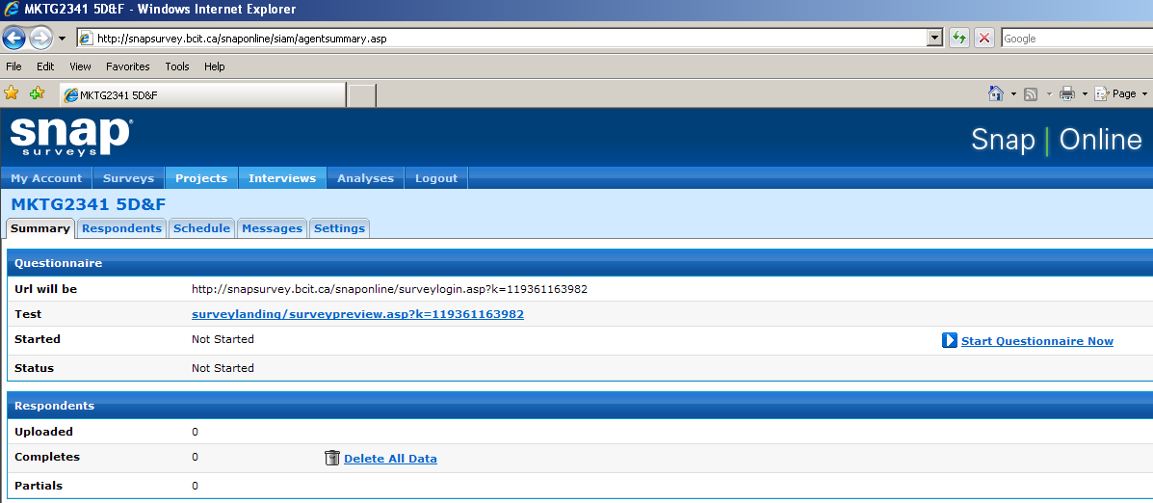
Survey URL
The URL is here
MKTG2341-09 PCLab 6

Slide 24
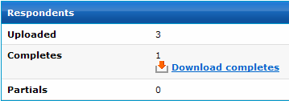
Completed Surveys
Mail out invitations & wait for the respondents to complete the questionnaire.
To see the completed responses click: Interview | Summary
In the Respondents section, Completes: see icon
MKTG2341-09 PCLab 6

Slide 25
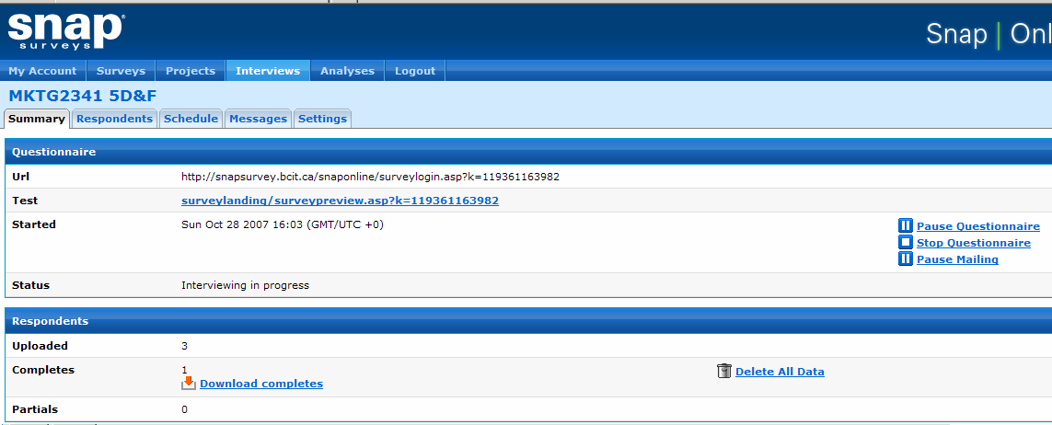
Completed Surveys
MKTG2341-09 PCLab 6

